Slide 1


CPTS 483
HW#3 Possible Solutions
Presented by-
Shariful Hasan Shaikot
TA CPTS 483

Slide 2
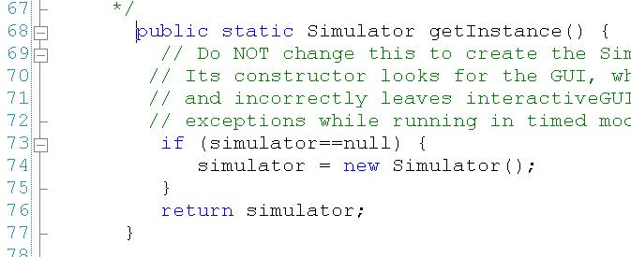

Slide 3
getInstance method is not synchronized
check-then-act race condition

Slide 4
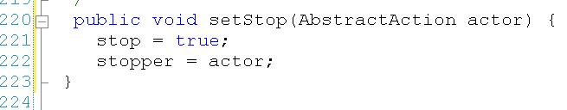

Slide 5
setStop(…) function assigns values to two related volatile fields in the simulatorThread object.
If the thread were pre‐empted between lines 221 and 222…then ???
These member variables need to be assigned and read under a common lock.

Slide 6


Slide 7
the yield() call will allow the main thread to run so that the GUI can get set before the simulation thread begins execution.
can never be guaranteed because it is running asynchronously to the SimThread.
Since it cannot be guaranteed, this is not thread‐safe.

Slide 8
Thank you for listening

